Slide 1
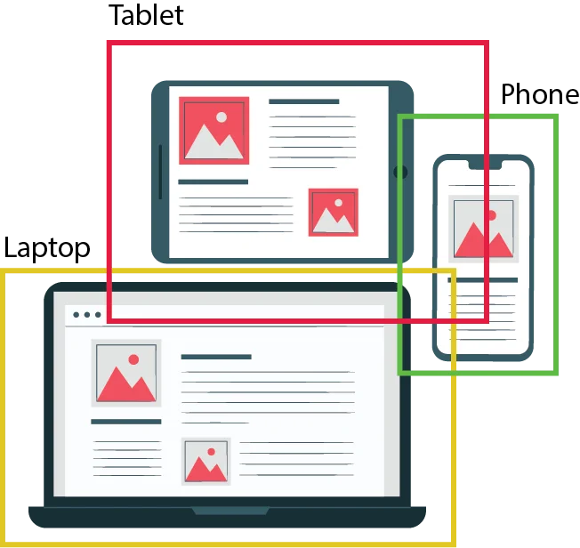
YOLO
Network
Object Detection
in real time
Name: Akhmedov Yusufjon Muhammad ugli Major: Computer Engineering
Student Number: 202438404

Slide 2
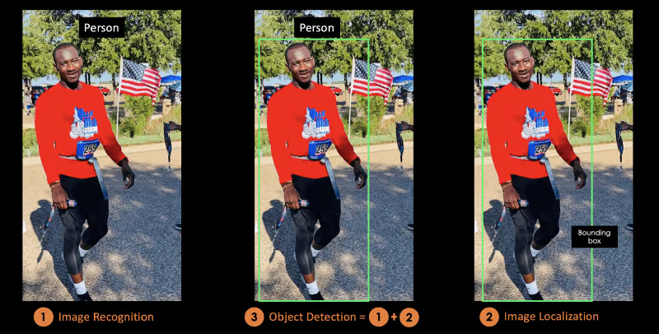
WHAT IS OBJECT DETECTION ACTUALLY?
Object detection is a computer vision technique for identifying and localizing objects within an image or a video.

Slide 3

WHAT IS YOLO Network
WHY YOLO is popular
HOW DOES YOLO work
QUESTION MARK

Slide 4




YOLO – (You Only Look Once) real-time object detection algorithm
2015 – Start of history by Joseph Redmon, Santosh Divalla, Ross Girshick, Ali Farhadi – YOLO v1

Slide 5

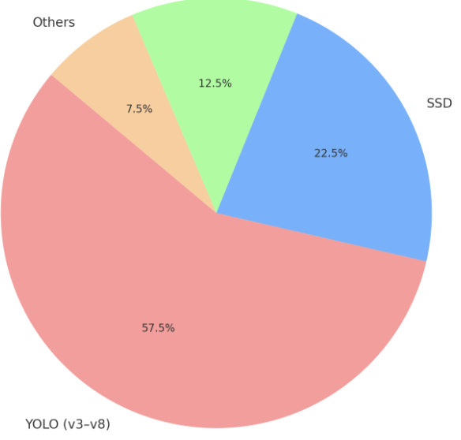



Popular?
Extremely fast – frames per second 45 FPS ~ 91 FPS
Also compared to other detectors (SSD, R-CNN, etc.)
High detection accuracy
with few background errors
Open source –
publicly available for everyone
Forking - Many improvements in a limited time
GitHub Forks

Slide 6
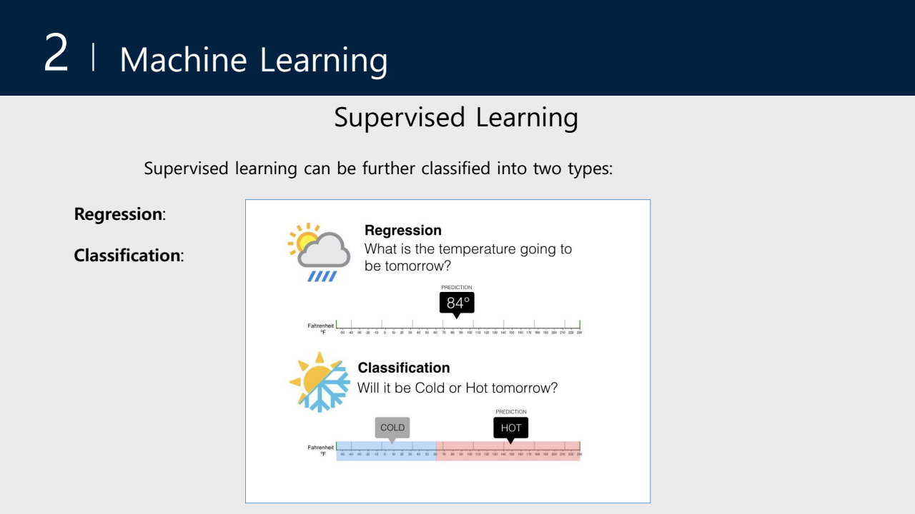

Slide 7
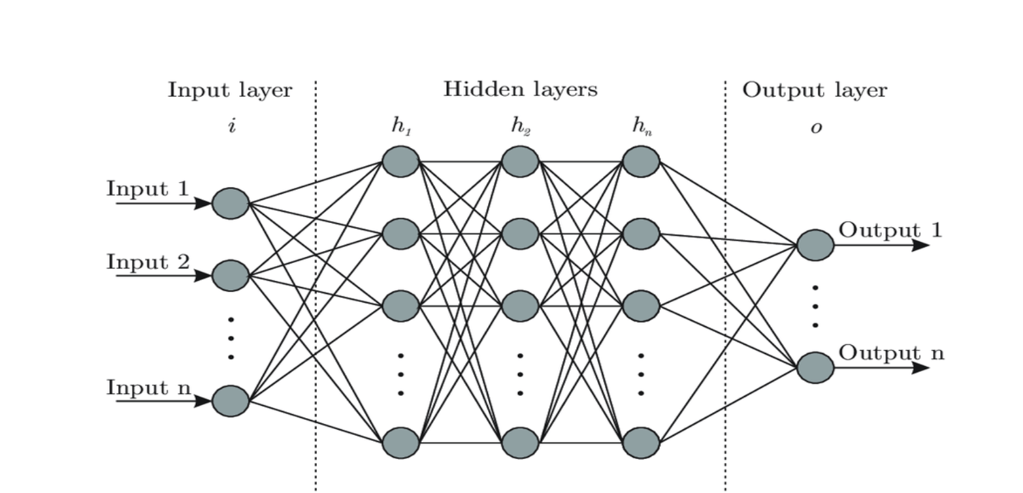
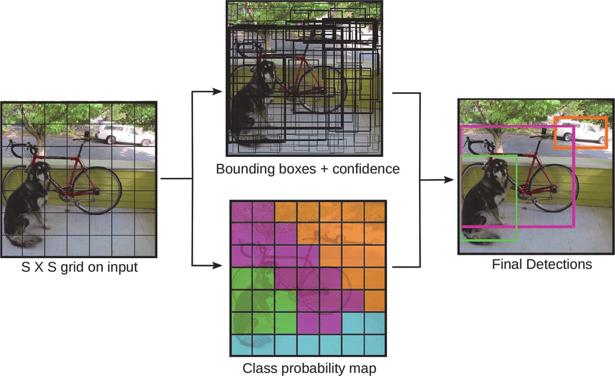
YOLO IS A DL model - identifies and locates multiple objects in an image using
a single forward pass through a convolutional neural network (CNN). The authors frame the object detection problem as a regression rather than a classification task by spatially separating bounding boxes and associating probabilities to each detected image using a single convolutional neural network (CNN).

Slide 8
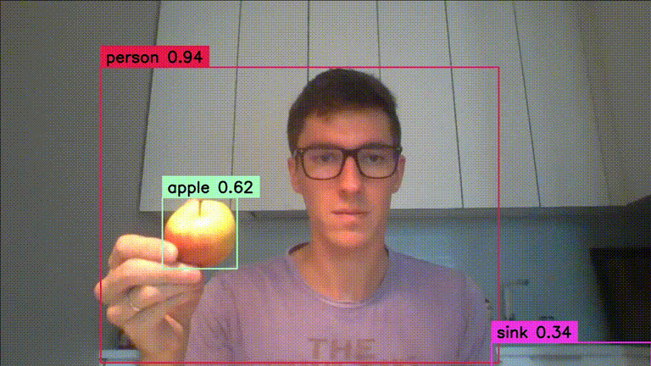
Real-time object detection
YOLO

Slide 9
YOLOv1 was a groundbreaking start — simple but limited.
It uses a single CNN to divide the image into a 7×7 grid and predicts bounding boxes and classes in one pass.
It’s fast but struggles with small or overlapping objects and has limited accuracy.

Slide 10
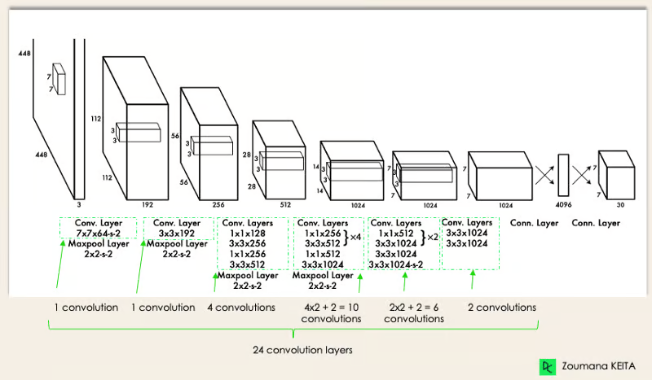
YOLO V1 Architecture - 2015
CNN Simple Explanation
CNN Complete Explained
YOLO Network Exmplained

Slide 11
YOLOv8 (your "YOLOv11") is a powerful, modern, and production-ready system capable of high-precision detection across tasks and devices.
YOLOv8 is a modern, high-performance object detection model built by Ultralytics.
It uses advanced CNN architecture with multi-scale detection and anchor-free methods for better accuracy.
YOLOv8 supports detection, segmentation, and classification, and is optimized for real-time use on various devices.

Slide 12
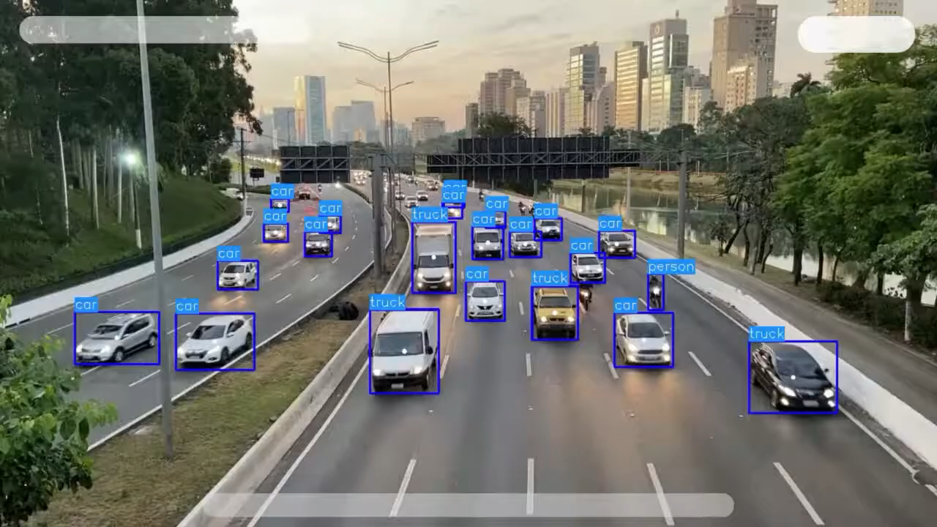

Slide 13
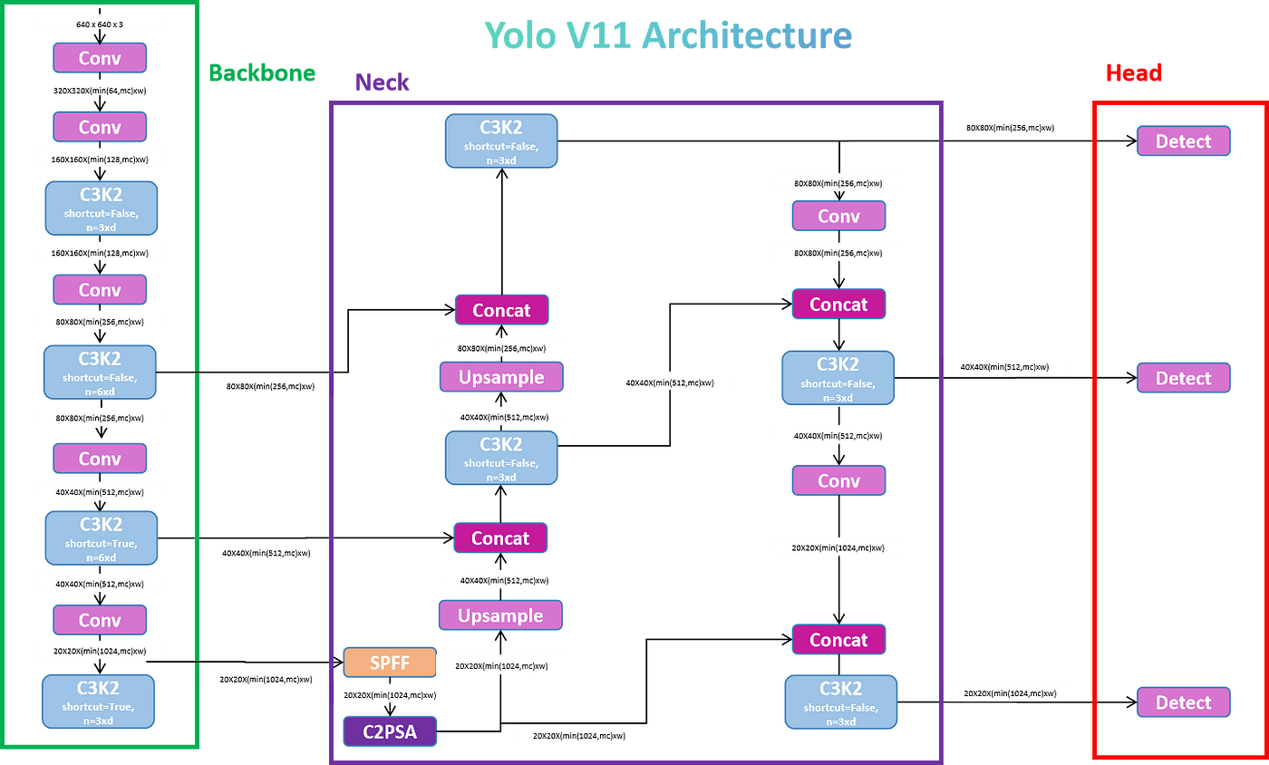
Yolov8 -> Ultraliytcs 2024 -> “Yolo 11”
Blog Post
Explanation YOLO 8 Architecture

Slide 14
YOLO Applications Real life examples

Slide 15
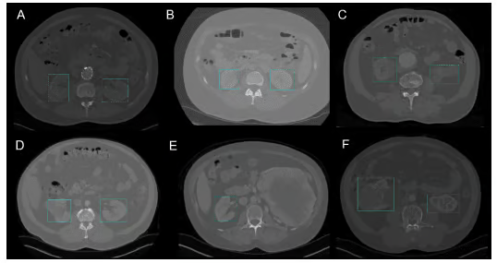
Healthcare - Kidney Detection in CT using YOLO v3e

Slide 16
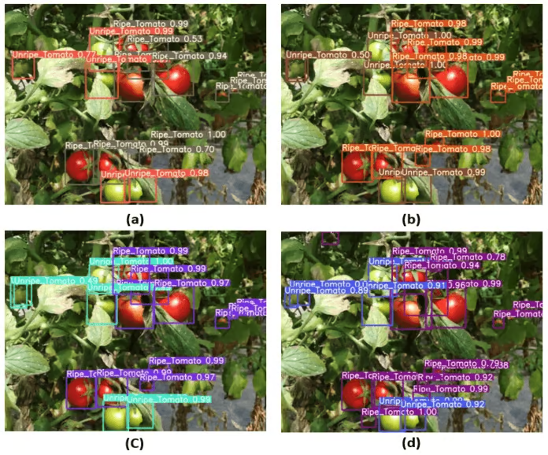
Agriculture - Harvesting robots are vision-based robots that were introduced to replace manual picking of fruits

Slide 17
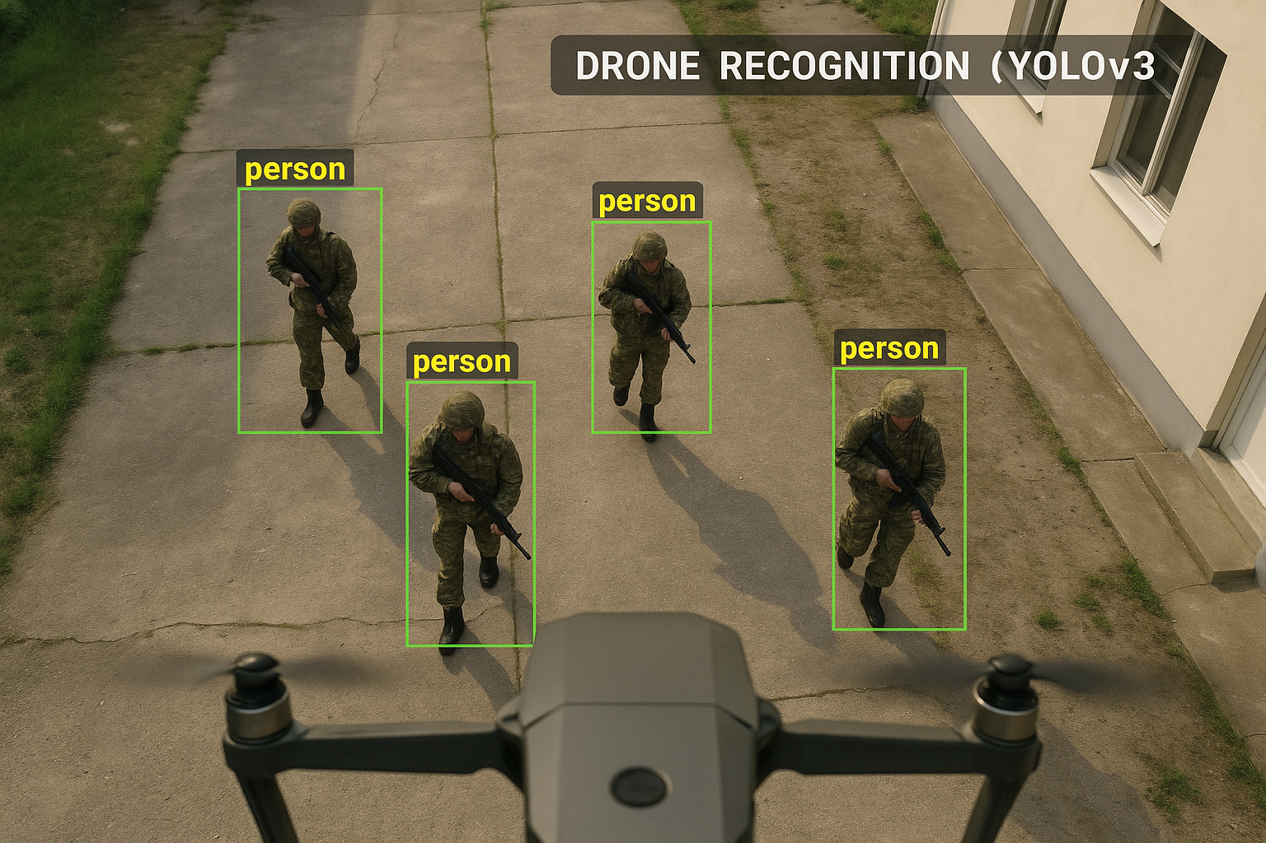
Military - YOLO is used in drones to detect and track people, vehicles, weapons, and infrastructure in real time.

Slide 18
Short Conclusion
YOLO (You Only Look Once) is a fast and efficient real-time object detection system that predicts bounding boxes and class labels in a single pass, offering high speed and accuracy.
PS: AI can cure, feed or even kill.
YOLO (AI model) is the most popular and the best example for that.

